Slide 1
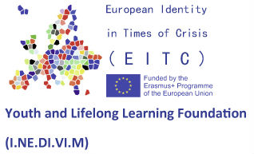
European Identity in times of crisis (EITC)
Unemployment 2nd Quarterly data 2016
1st Second Chance School of Thessaloniki, Greece www.1sdethes.gr
Notes:
1

Slide 2
Students are responsible for the processing, the visualization and the content of this presentation.
Sources from:
Manpower Employment Organization (OAED) (www.oaed.gr)
Wikipedia (www.wikipedia.org)
Municipality of Thessaloniki (http://www.thessaloniki.gr/portal/page/portal/EnglishPage)
Hellenic Statistical Authority (http://www.statistics
1st Second Chance School of Thessaloniki, Greece www.1sdethes.gr

Slide 3
Greece ….thessaloniki
1st Second Chance School of Thessaloniki, Greece www.1sdethes.gr

Slide 4
THESSALONIKI
Thessaloniki (Greek: Θεσσαλονίκη )is the second-largest city in Greece and the capital of Greek Macedonia, the administrative region of Central Macedonia and the Decentralized Administration of Macedonia and Thrace.
1st Second Chance School of Thessaloniki, Greece www.1sdethes.gr

Slide 5
THESSALONIKI - history
Its nickname is η Συμπρωτεύουσα (Symprotévousa), literally "the co-capital", a reference to its historical status as the Συμβασιλεύουσα (Symvasilévousa) or "co-reigning" city of the Eastern Roman (Byzantine) Empire, alongside Constantinople.
1st Second Chance School of Thessaloniki, Greece www.1sdethes.gr

Slide 6
THESSALONIKI - population
The municipality of Thessaloniki, the historical center, had a population of 325,182 in 2011, while the Thessaloniki Urban Area had a population of 763,952. and the Thessaloniki Metropolitan Area had 1,012,297 inhabitants in 2011.
1st Second Chance School of Thessaloniki, Greece www.1sdethes.gr

Slide 7
Attractions
of Thessaloniki
Church of Agios Dimitrios
This enormous 5th-century structure honours Thessaloniki’s patron saint.
Museum of Byzantine Culture
This fascinating museum has plenty of treasures to please Byzantine buffs, plus simple explanations to introduce the empire to total beginners.
Noesis Science Center & Technology Museum
Although 6km east of town, this fascinating museum of science and technology, old and new, is worth visiting
1st Second Chance School of Thessaloniki, Greece www.1sdethes.gr

Slide 8
Attractions
of Thessaloniki
Kastro & Byzantine Walls
The kastro (castle) encloses Byzantine churches and timber-framed houses with overhanging upper storeys.
Jewish Museum of Thessaloniki
This touching museum is housed in one of the few Jewish buildings to survive the great fire of 1917, the former office of Jewish newspaper L'Independent.
…and many more
1st Second Chance School of Thessaloniki, Greece www.1sdethes.gr

Slide 9
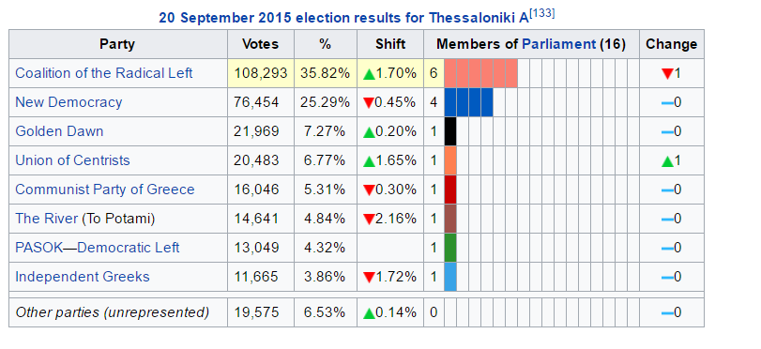
1st Second Chance School of Thessaloniki, Greece www.1sdethes.gr

Slide 10
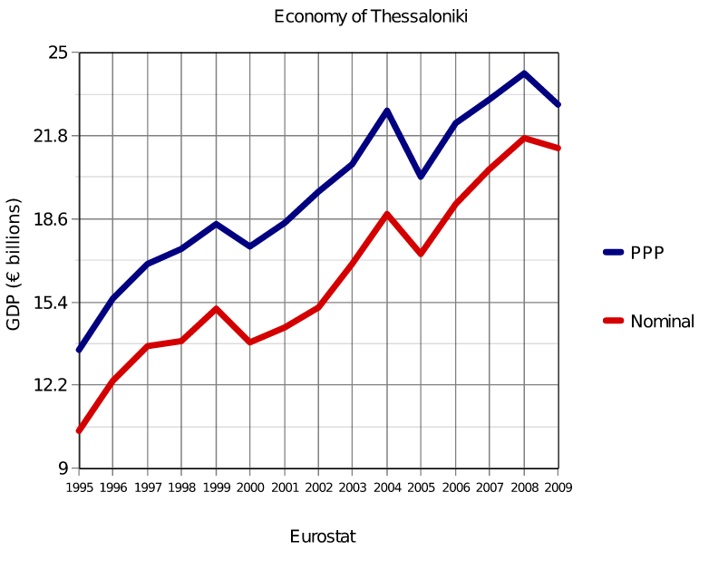
Economy
GDP €19.851 billion (PPP, 2011)[2]
GDP rank 2nd in Greece
GDP growth -7.8% (2011)
GDP per capita €17,200 (PPP, 2011)
1st Second Chance School of Thessaloniki, Greece www.1sdethes.gr

Slide 11
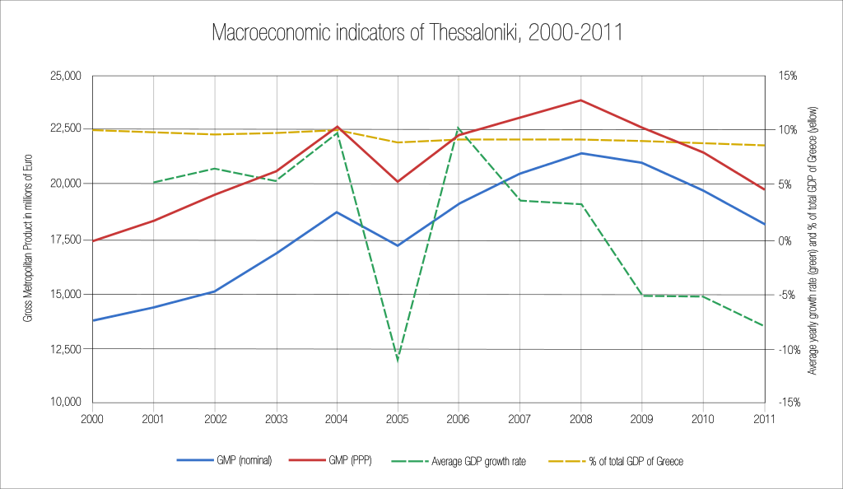
GDP of the Thessaloniki regional unit 2000–2011
1st Second Chance School of Thessaloniki, Greece www.1sdethes.gr

Slide 12
Unemployment 2nd Quarterly data 2016
Total Work Force 383000
Employed 279000
Unemployed 104000
1st Second Chance School of Thessaloniki, Greece www.1sdethes.gr
Notes:
12

Slide 13
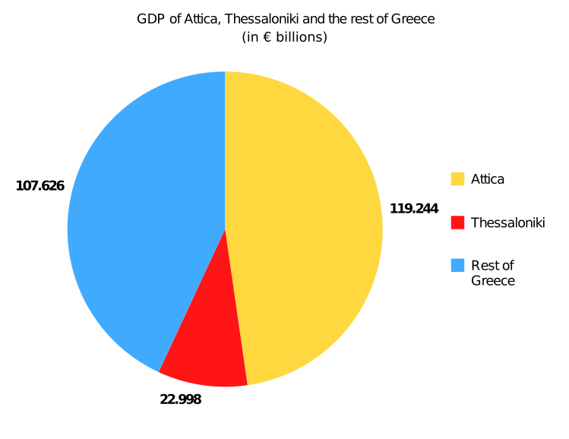
Population
Greece Total 10.900.000
Attica 3.700.000
Thessaloniki 1.000.000
1st Second Chance School of Thessaloniki, Greece www.1sdethes.gr

Slide 14
Living in thessaloniki
Thessaloniki is a multicultural place. People from more than 30 countries live, work and enjoying the facilities of the city
1st Second Chance School of Thessaloniki, Greece www.1sdethes.gr

Slide 15
Unemployment 2nd Quarterly data 2016
Total population 763000
Non contributing financially 380000
Contributing financially 383000
1st Second Chance School of Thessaloniki, Greece www.1sdethes.gr

Slide 16
Unemployment 2nd Quarterly data 2016
Unemployment 2015 29,5
Unemployment 2016 27,1
1st Second Chance School of Thessaloniki, Greece www.1sdethes.gr

Slide 17
Unemployment 2nd Quarterly data 2016
Population
2013 →800000
2016 →763000
1st Second Chance School of Thessaloniki, Greece www.1sdethes.gr

Slide 18
Unemployment 2nd Quarterly data 2016
Emigration
Population that moved from the state of unemployed to non contributing financially
1st Second Chance School of Thessaloniki, Greece www.1sdethes.gr

Slide 19
Unemployment 2nd Quarterly data 2016
Men 40%
Women 60%
1st Second Chance School of Thessaloniki, Greece www.1sdethes.gr

Slide 20
Refugees in Greece
Jan. 2017
Total Greece 62784
North Greece 25000
Thessaloniki Area 8500
1st Second Chance School of Thessaloniki, Greece www.1sdethes.gr

Slide 21
outbound immigrants
 | 2008 | 2009 | 2010 | 2011 | 2012 | 2013 | 2014 | 2015
FEMALE | 18.932 | 19.051 | 29.093 | 33.429 | 44.160 | 42.130 | 39.866 | 44.086
MALE | 24.112 | 24.635 | 32.948 | 58.975 | 80.534 | 74.964 | 66.938 | 65.265
SUM | 43.044 | 43.686 | 62.041 | 92.404 | 124.694 | 117.094 | 106.804 | 109.351
1st Second Chance School of Thessaloniki, Greece www.1sdethes.gr

Slide 22
Thessaloniki was and still is a multicultural city. Its population continues to grow rapidly, with more and more young people from all over the world wanting to settle here. The impact of this in combination with its geographic location constitutes a comparative advantage for the city. The city of Thessaloniki is awaiting its deserved advancement to one of the outstanding cities of the world.
1st Second Chance School of Thessaloniki, Greece www.1sdethes.gr

